Slide 1


Warsaw-Radom Airport Building a Regional Airport Ecosystem: Retail Innovation and Workforce Development
Grzegorz Tuszyński
Director, Warsaw-Radom Airport,
MSc (Aerospace Engineering), MBA
ACI EUROPE Regional Airports Conference & Exhibition 2026, Torino

Slide 2
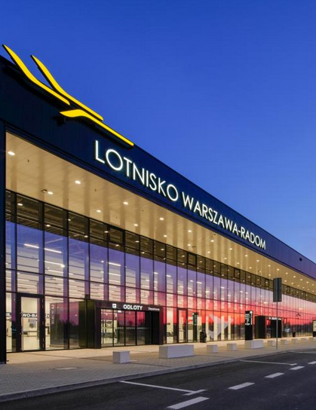
Regional airports don’t struggle because of lack of infrastructure
They struggle because of two things:
low non-aeronautical revenue
shortage of people
At Warsaw–Radom Airport – and across Polish Airports – we tackle exactly these two structural challenges facing airports today.
Instead of treating them as separate problems, we choose to address them as part of one integrated approach.
Notes:
Do regional airports struggle because of lack of infrastructure?

Slide 3
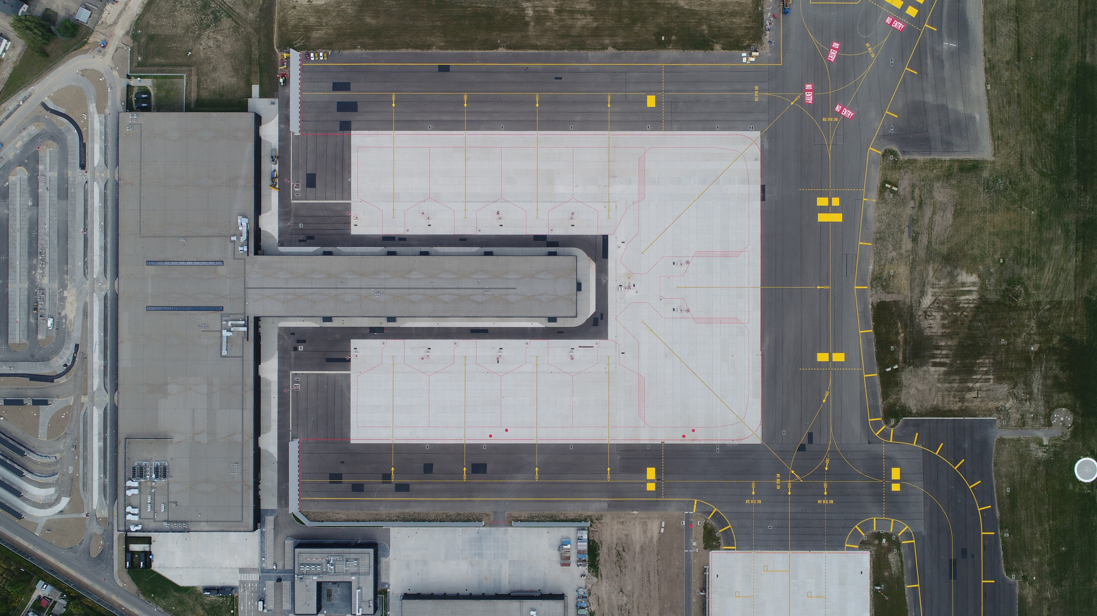
Let me start with the first challenge: non-aeronautical revenue.
Regional airports often struggle to generate stable, diversified commercial income.
Regional airport in Poland, but where are the aircrafts ? …
Notes:
Just to make the picture clear for you, this is of APRON 1 at Warsaw-Radom Airport with the terminal building and PIRS - 11 aircraft stands around it.

Slide 4
Instead of asking how to sell more to passengers, we asked a different question:
What if the airport could attract people who are not passengers at all?
Notes:
Do regional airports struggle because of lack of infrastructure?

Slide 5
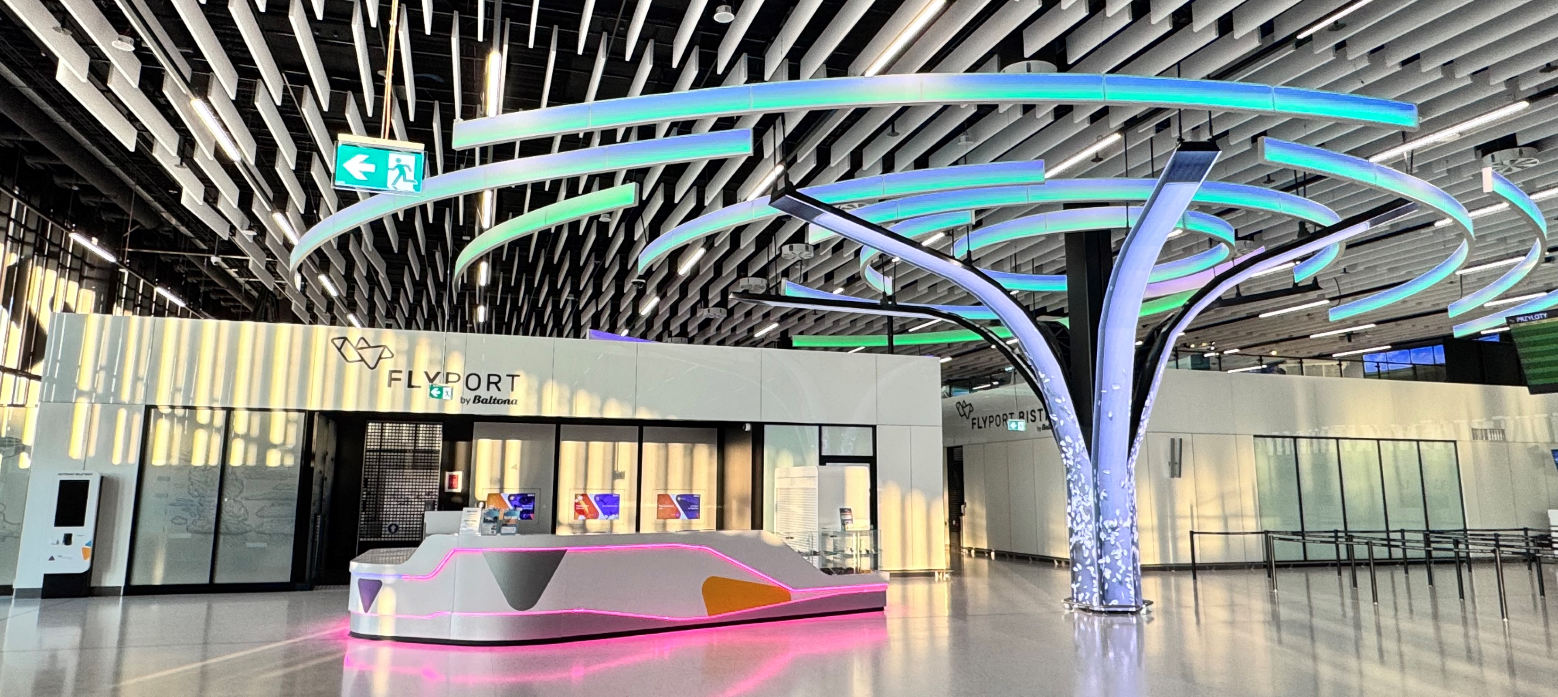
Not as a retail concept – but as an aviation-themed Educational and Entertainment Center, located inside a passenger terminal – landside – available to everyone.
This is why FlyPort by Baltona was created.

Slide 6
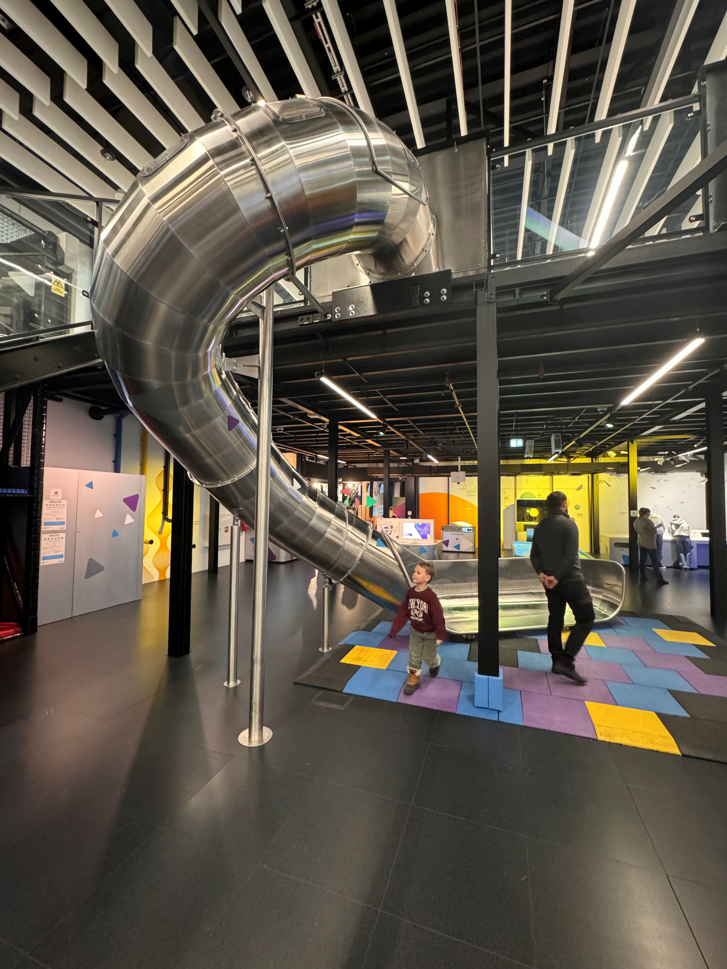
What is FlyPort?
Flyport is a 1,000-square-metre interactive space with over 60 stations, designed mainly for children and young people, but in reality, engaging all ages.
It combines education and entertainment—covering topics such as flight, airport operations, space, and aerospace technology.

Slide 7
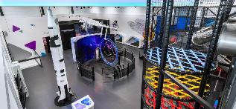
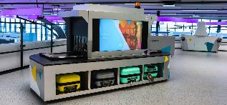
It operates across four thematic zones, offering hands-on experiences—from flight simulators and air traffic concepts, to space exploration and airport systems.
Within ”From dreams to clouds” zone:
You will learn how the propeller works,
You will try radio-communication,
You will learn about the history of aviation,
You will send a rocket into the air.
In the ”Earth, space and us” zone:
You will control the lunar rovers,
You will experience a journey to Mars,
and finally – the elewator ride into the orbit!
”Airport’s user’s manual” is a place where you can learn about:
how to control a flight,
radar operations,
airport construction.
In the ”Play zone” you can enjoy:
Spider Tower,
obstacle course,
slide,
and even a gyroscope!

Slide 8
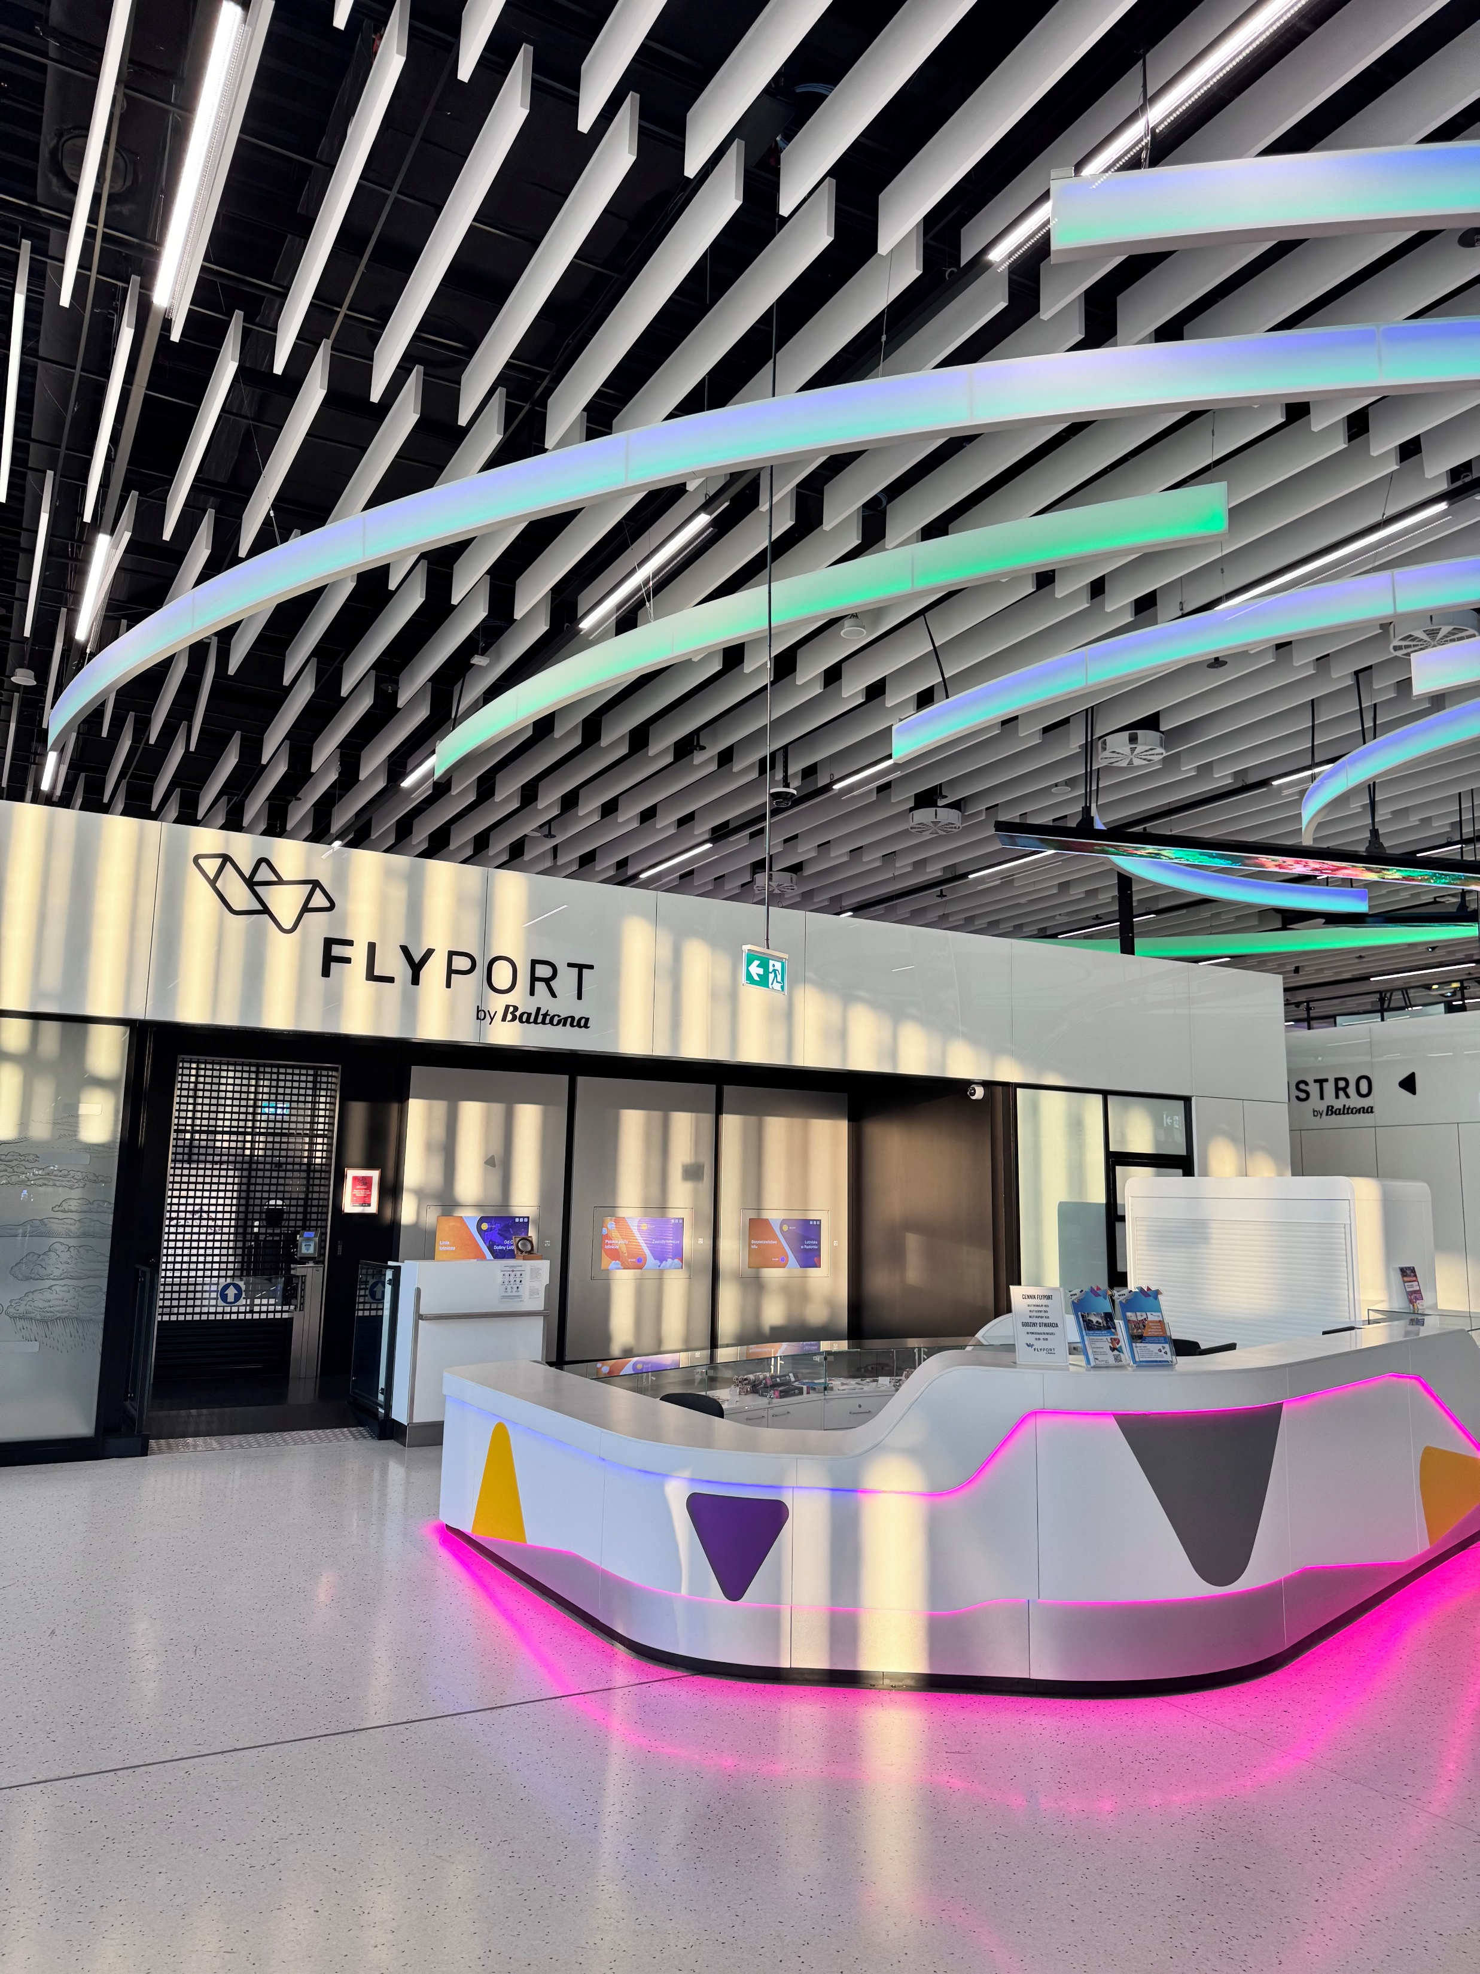
The key idea is simple:
instead of relying only on passenger traffic
the airport becomes a destination itself.

Slide 9
Does it work?
In its first year, FlyPort attracted around 40,000 visitors, with over half coming from organized groups such as schools.
FlyPort creates a completely new, stable source of non-aeronautical revenue, independent from flight schedules.
Consistently rated a perfect 5.0 on Google Maps, based on 428 reviews.

Slide 10
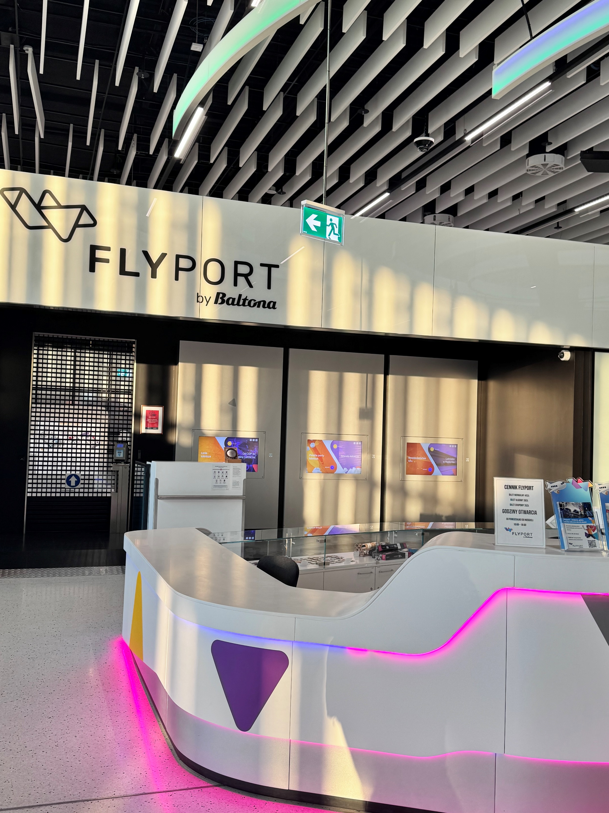
Does it work?
But beyond revenue, it also builds something equally important:
early engagement with future generations interested in aviation.

Slide 11
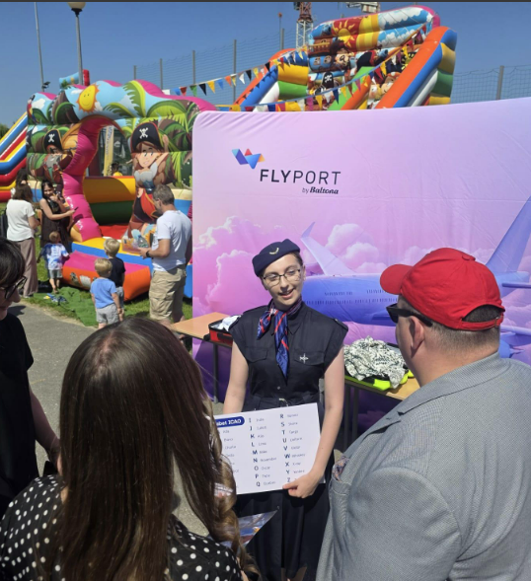
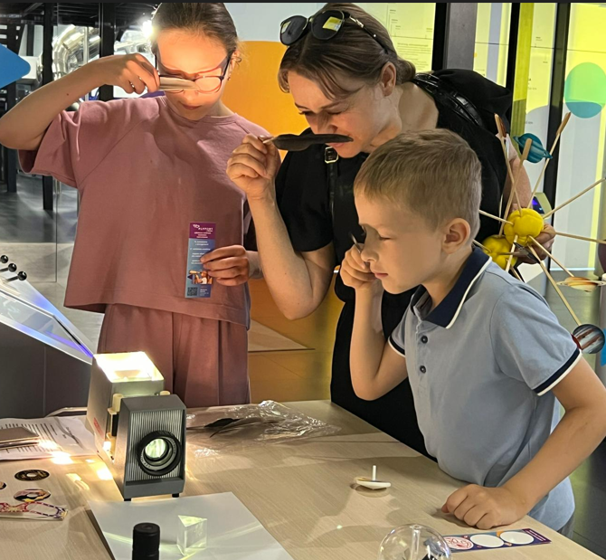
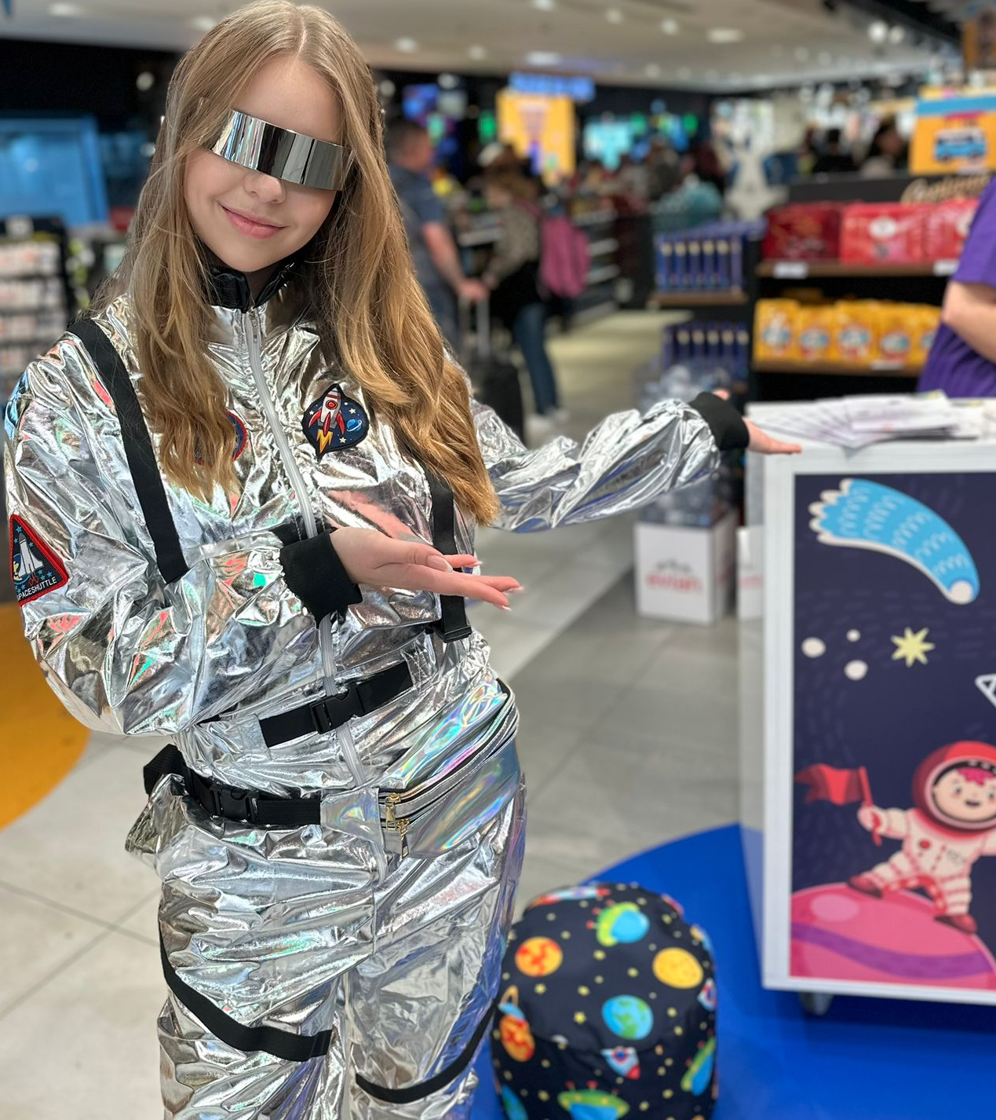

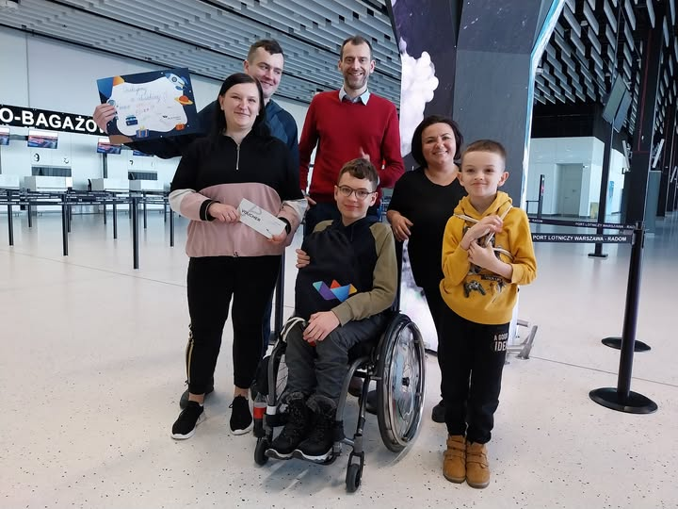
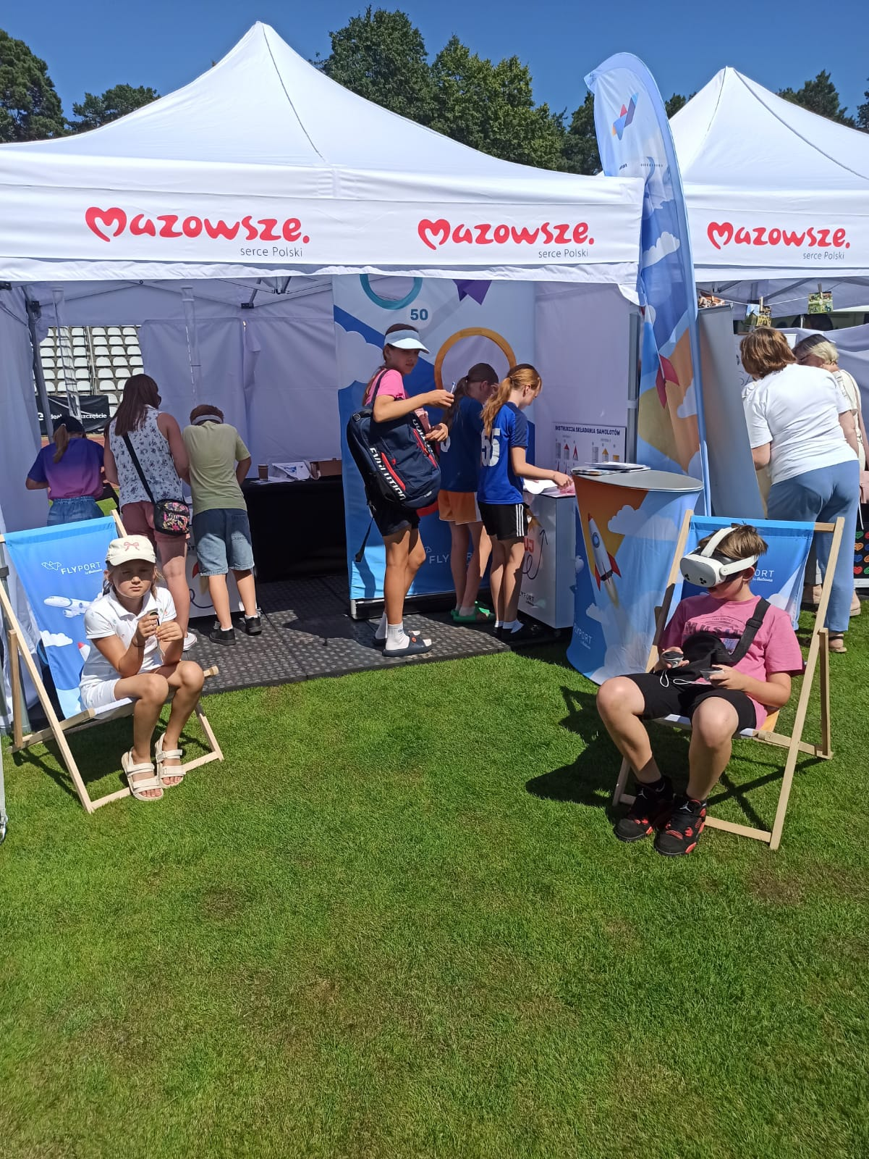
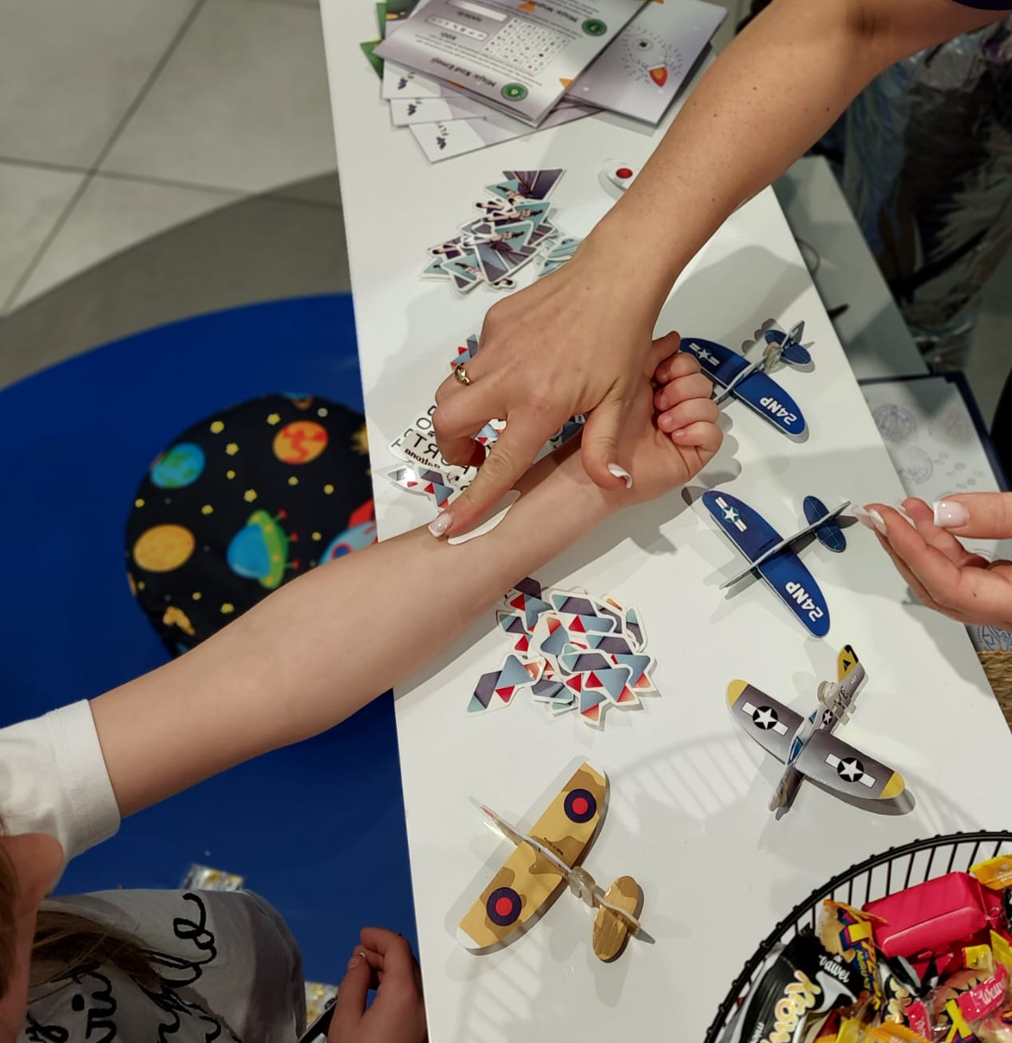
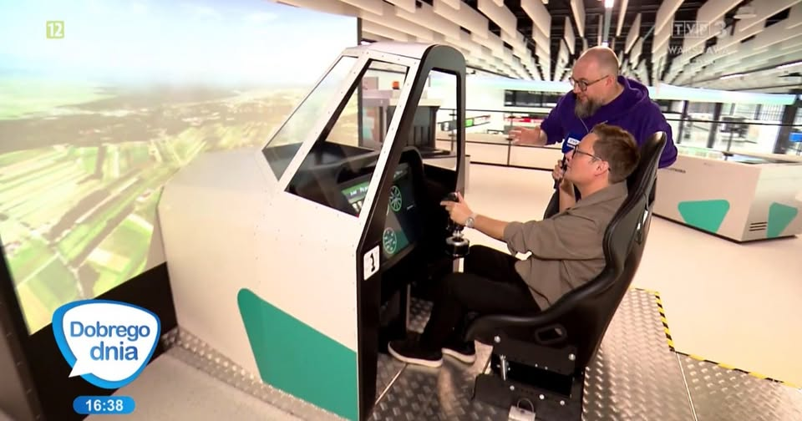


It is visible in local media (radio, TV) as well as variety of themed picknics, different airports, and workshops
Notes:
PG

Slide 12
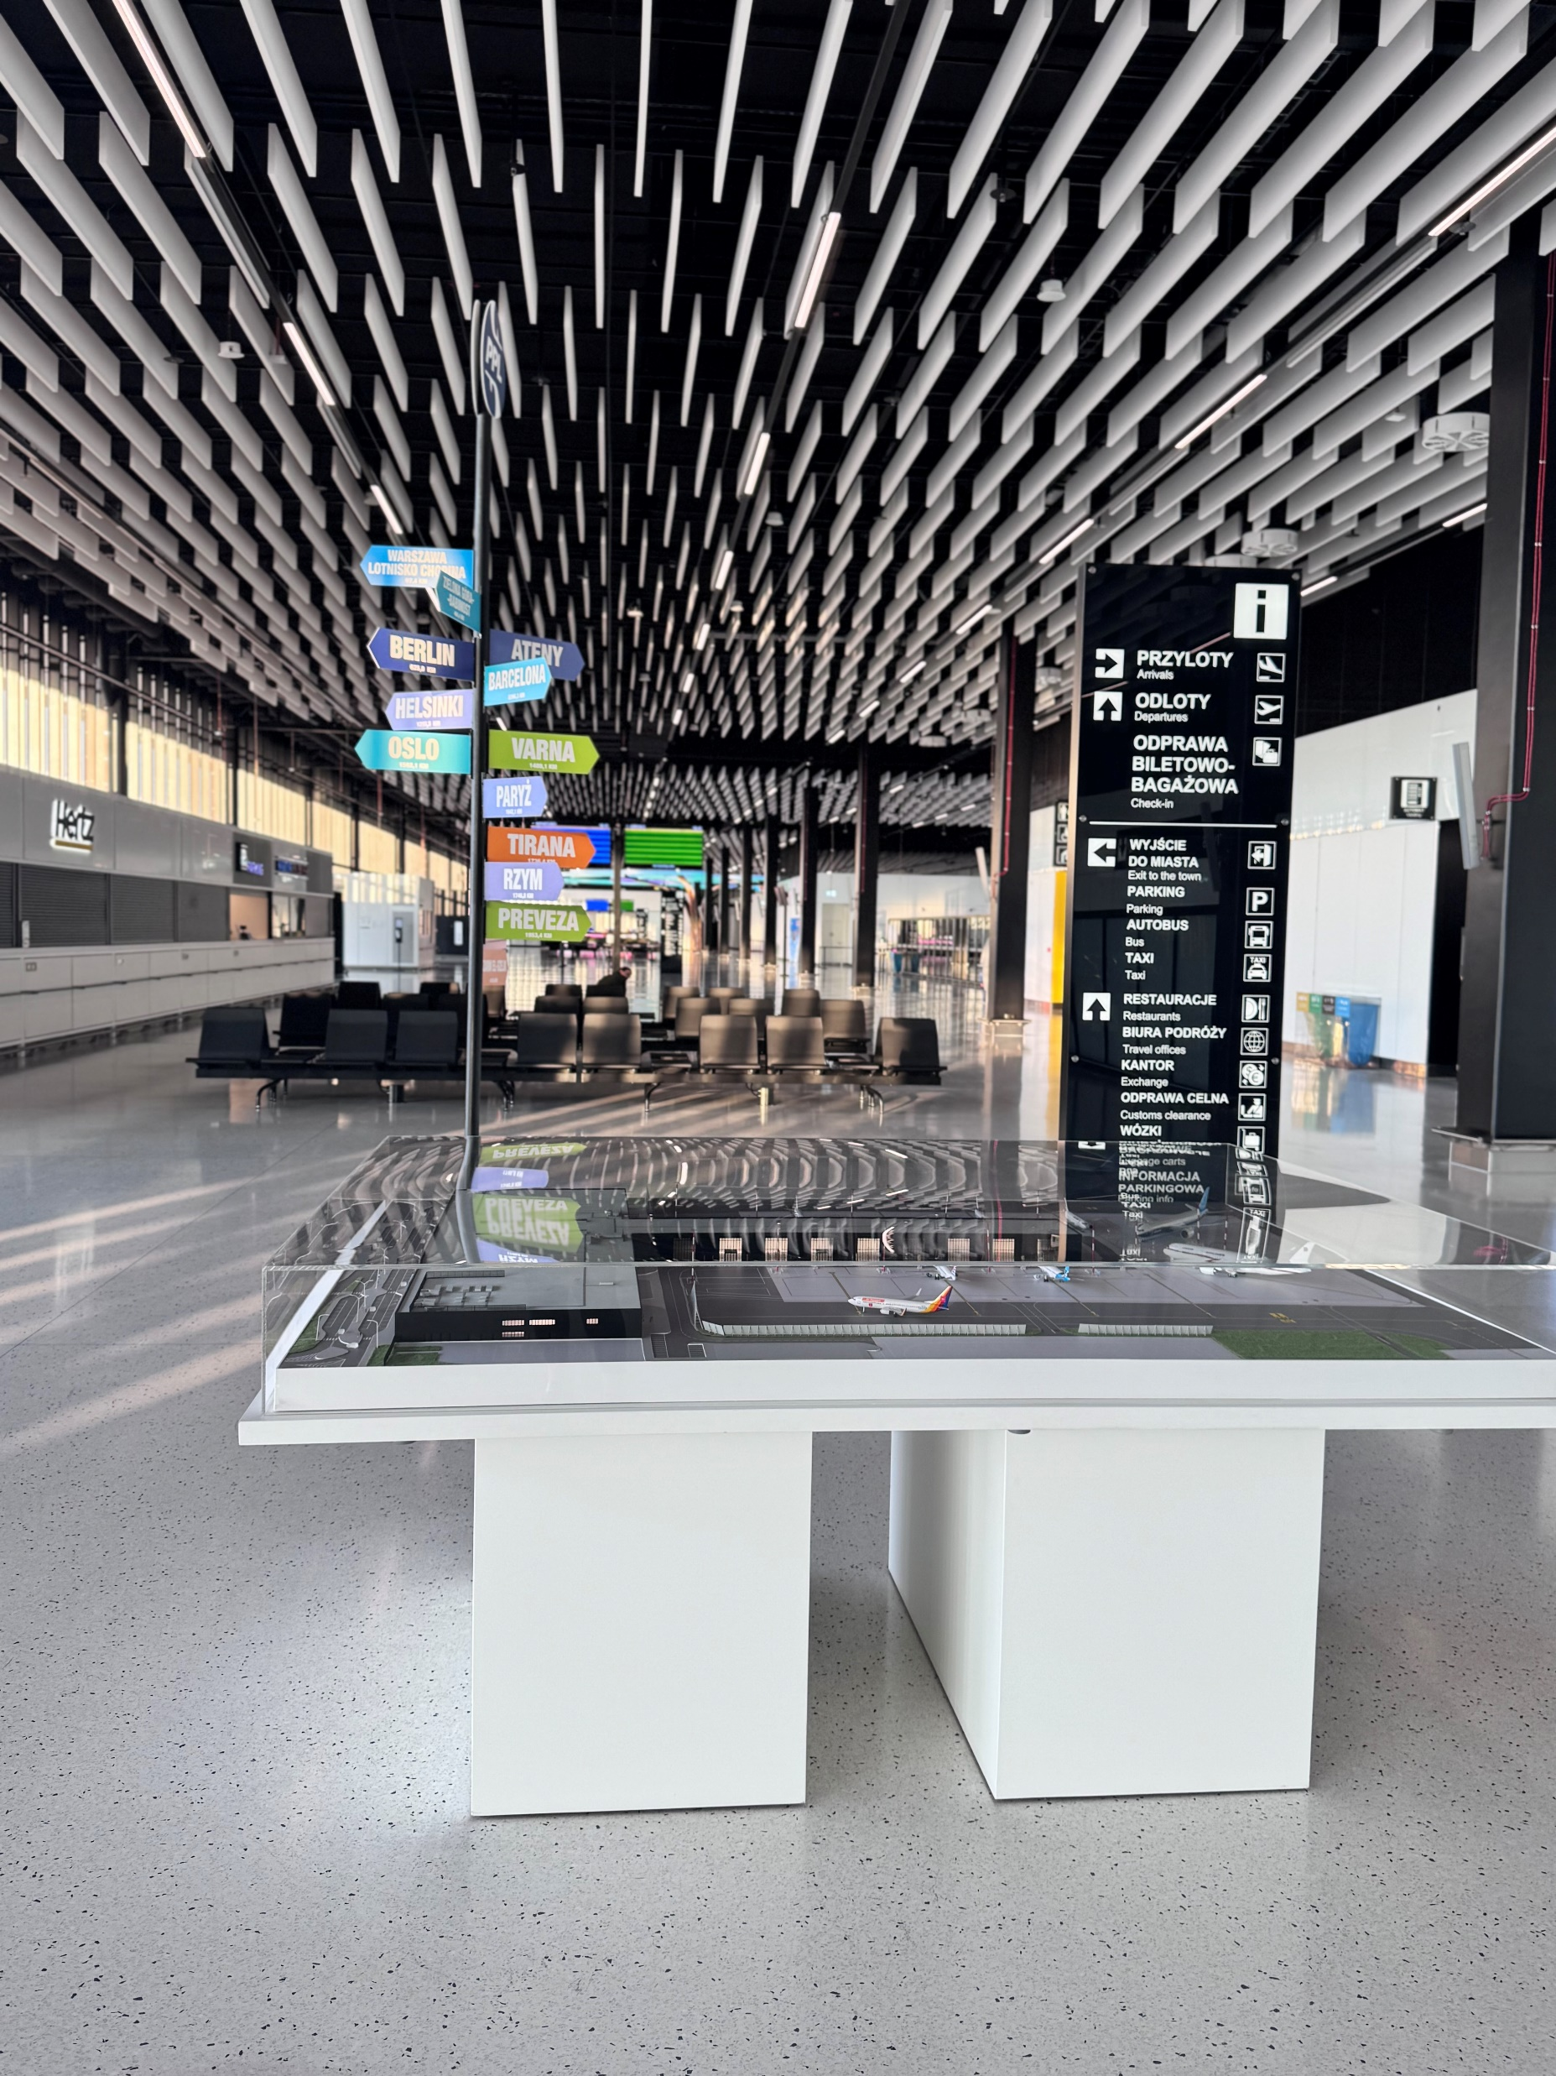
FlyPort brings people to the airport …

Slide 13

… but the next question is: how do we turn that interest into skills?

Slide 14
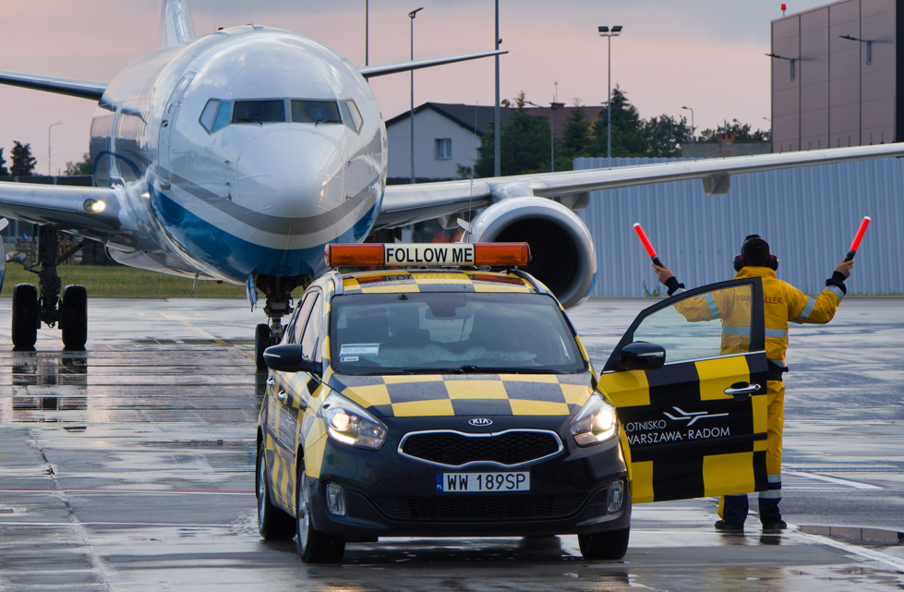
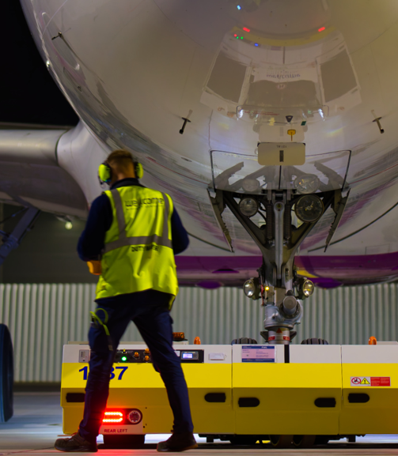
The shortage of skilled aviation personnel is not a local issue.
It is a systemic challenge affecting the entire aviation sector – across airports, ground handling, and operations.

Slide 15
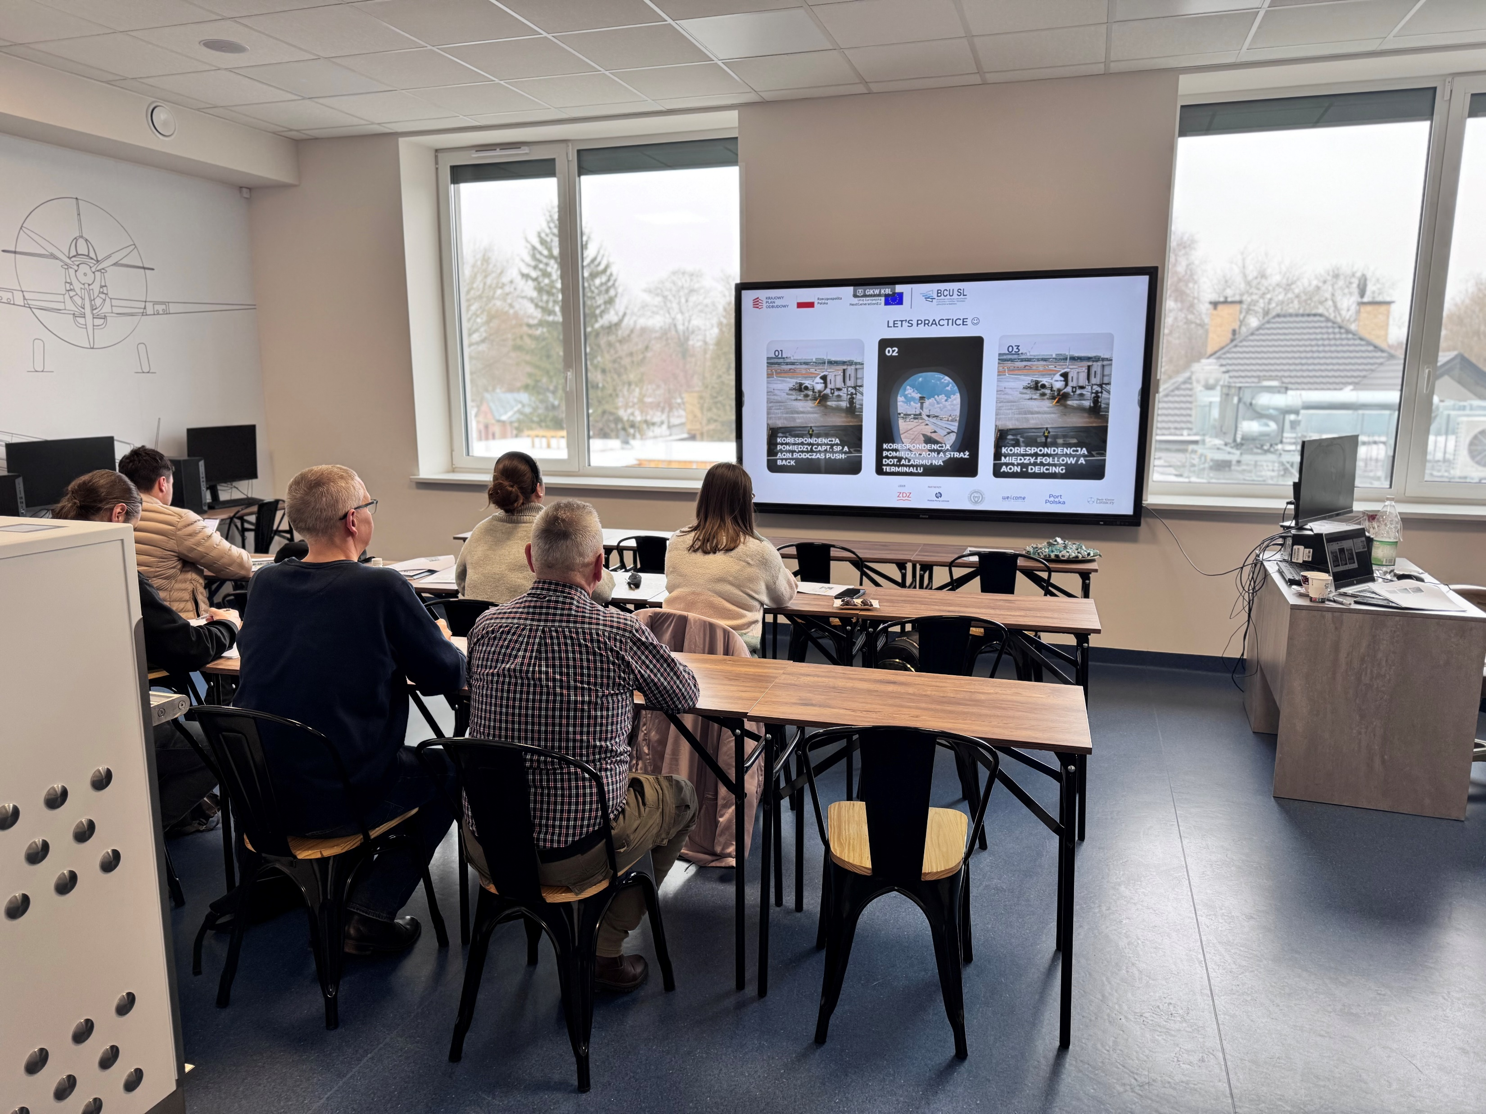
And the problem is not only lack of people – but the gap between education and real airport operations.
This is why we created the Industry Skills Centre for Airport Operations in Radom.

Slide 16
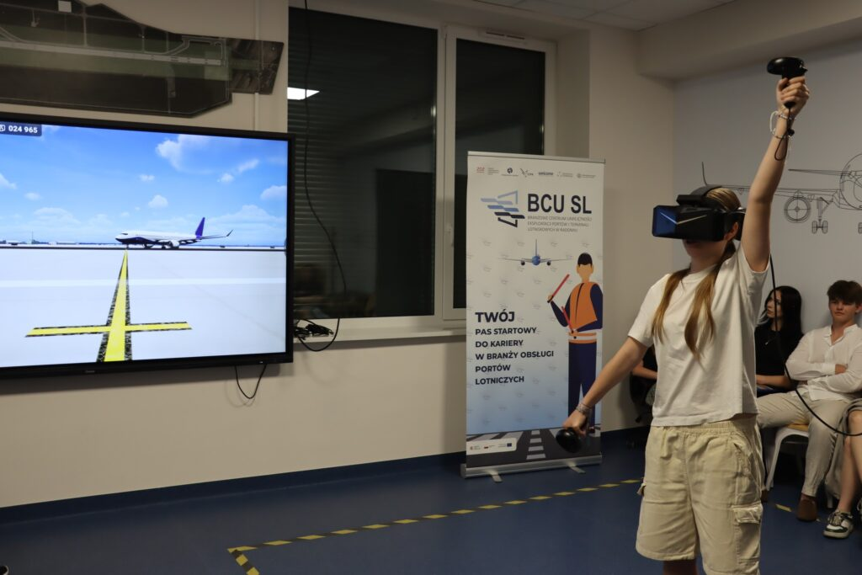
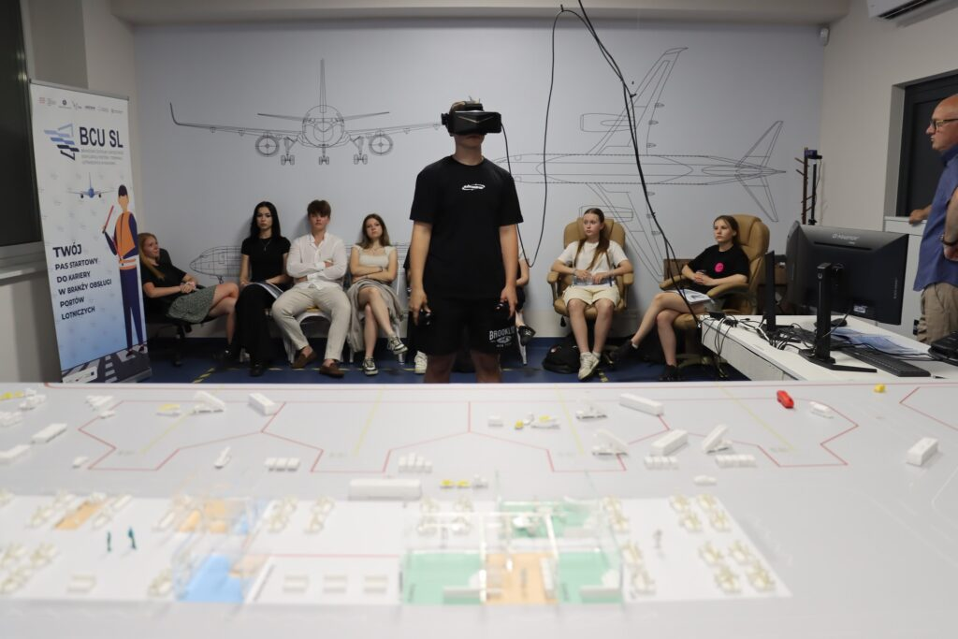
Industry Skills Centre for Airport Operations in Radom
Is a dedicated, industry-led training center designed to prepare people for real operational roles at airports – not only within Polish Airports, but across the whole aviation industry.

Slide 17
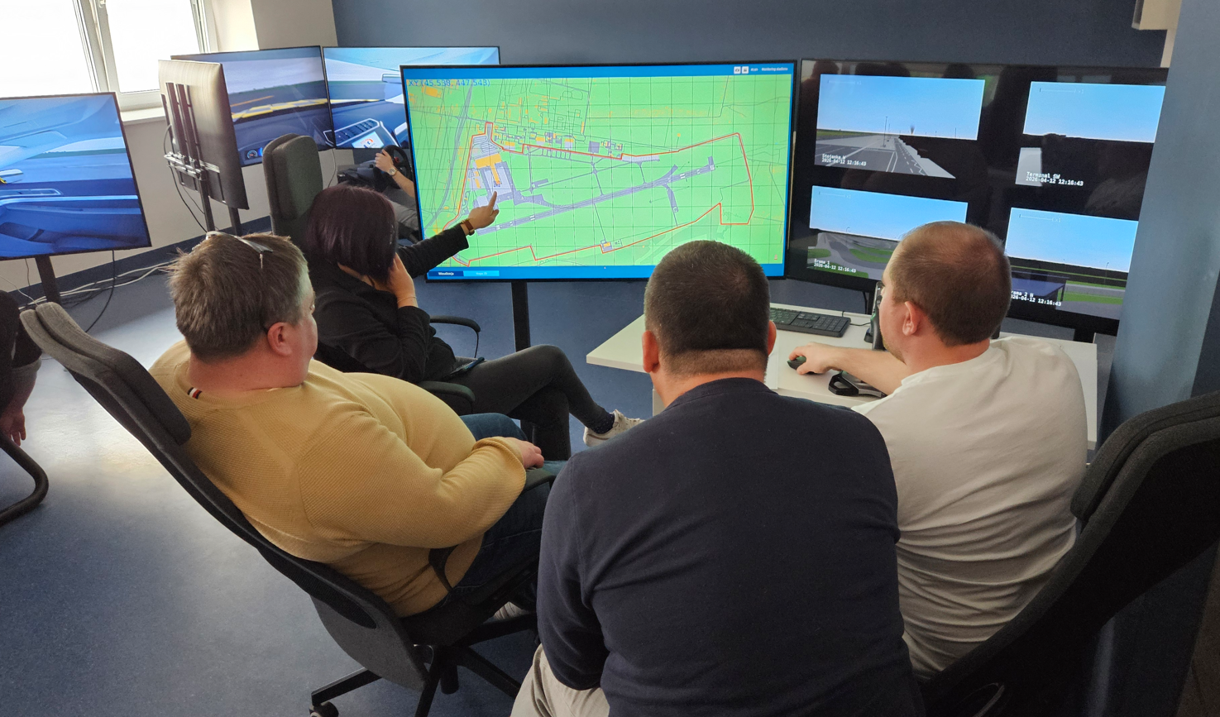
Industry Skills Centre for Airport Operations in Radom
The center provides training in key operational areas:
passenger handling,
airport operations,
data quality management,
ground movement,
emergency response.
It combines modern infrastructure with simulation-based learning, including VR technologies and realistic operational environments.

Slide 18
Industry Skills Centre for Airport Operations in Radom
But the real innovation is not the infrastructure – it is the model.
The center is built in close cooperation with industry partners – including airport operators, ground handling companies, and academic institutions.
Which means, we do not teach what schools think is needed – but what the industry actually requires:
operational decision-making under pressure,
real-time coordination across multiple stakeholders,
ability to respond effectively to unexpected situations

Slide 19
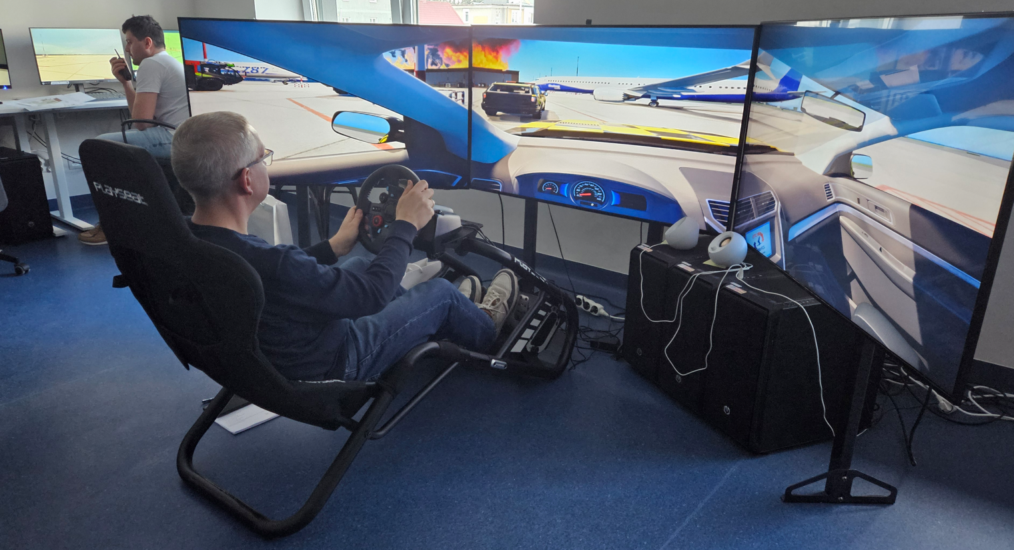
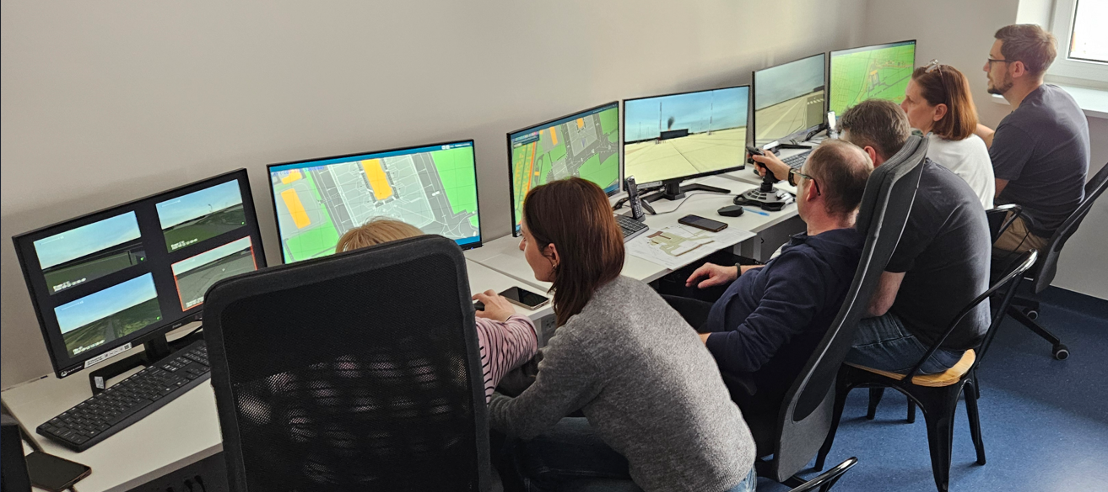
Industry Skills Centre for Airport Operations in Radom
As a result, we are creating a scalable pipeline of skilled professionals ready to work at airports across the country – independently of where they were trained.
In other words, not only do we train people – we align the educational system with everyday operational reality of aviation.

Slide 20
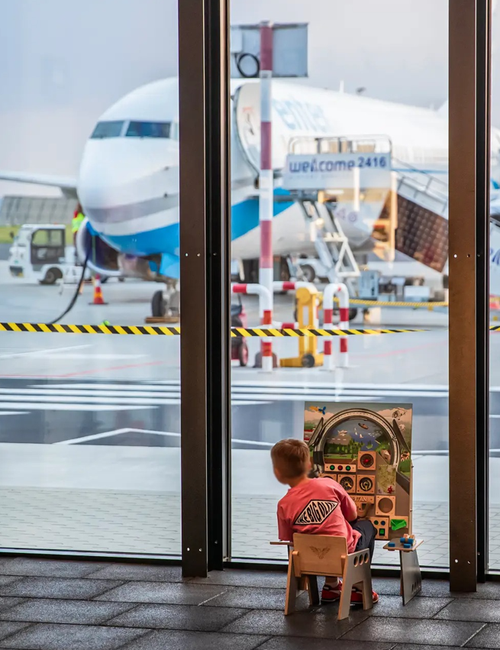
Industry Skills Centre for Airport Operations in Radom
And when you combine this with FlyPort, something interesting happens…
You create a system where the airport first attracts people – and then develops them into future professionals.

Slide 21
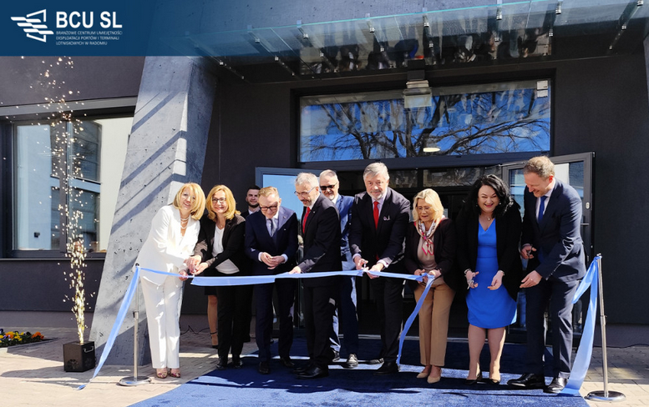
Industry Skills Centre for Airport Operations in Radom
This is what we mean by an airport eco-system:
not just infrastructure. not just passengers.
but a platform that connects experience, education, and operations.
As of regional airports, the future is not about scale …
… it is about integration.

Slide 22
THANK YOU!
GRZEGORZ TUSZYŃSKI
G.TUSZYNSKI@PPL.PL

